Slide 1
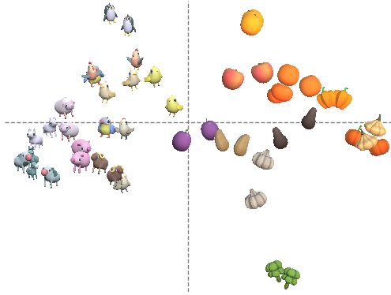
A
B
μ
σ
CONCEPT
y
EXEMPLAR
z
SAMPLE
t
i
j
ε
NOISE

